Slide 1
The fast track
Seller Experience
Notes:
We call Candex the fast track because it is the fast, easy & compliant way to make low value or one time purchases.

Slide 2
PAYEE
Payee Experience

Slide 3
PAYEE
Payee Invite
This email sent once the PO is approved Reminders sent regularly to get Payee acceptance: : 1, 2, 4, 7, 14, 17, 28, 10, 21 days
From: VCU (via Candex) Subject: Action Required: Accept Payment
Speaking Engagement - January
California | PO#: 67564453535
From
Request Payment
VCU
To: zach@miller.com A payment of 500 USD is authorized to you. Items: • Speaking Engagement - January Click here to get paid. VCU Industries uses Candex to engage and pay its valued and trusted partners without going through a cumbersome setup process
Candex allows business to engage and exchange payments in a compliant way without cumbersome setup in each other’s financial systems
View FAQs Support at support@candex.com
3

Slide 4
PAYEE
How it Works For Enterprise Pricing About
Sign In
Simple Payee Registration
Users can select their language To be filled out ONLY on initial engagement
Candex makes it easy to pay and get paid
Email
Language
A. If Payee is being paid as part of company
zack@miller.com
English ▾
This payment is to my company
This payment is to me personally
B. If Payee is being paid as an individual
First Name
Last Name
Phone Number
- select - ▾
Company
Job Title
Not shown if Payee selects ‘B’
Create Password
Confirm Password
Are you a small business? ◯ Yes ◯ No
?
Not shown if Payee selects ‘B’
Are you a diverse supplier? ◯ Yes ◯ No
?
I agree to the Candex Terms of Use and Privacy Policy
Register Now
4
Notes:
When the Payee clicks view order, this is the registration page that they will see. They can select their language and fill in some pretty easy information which usually takes under a minute.

Slide 5
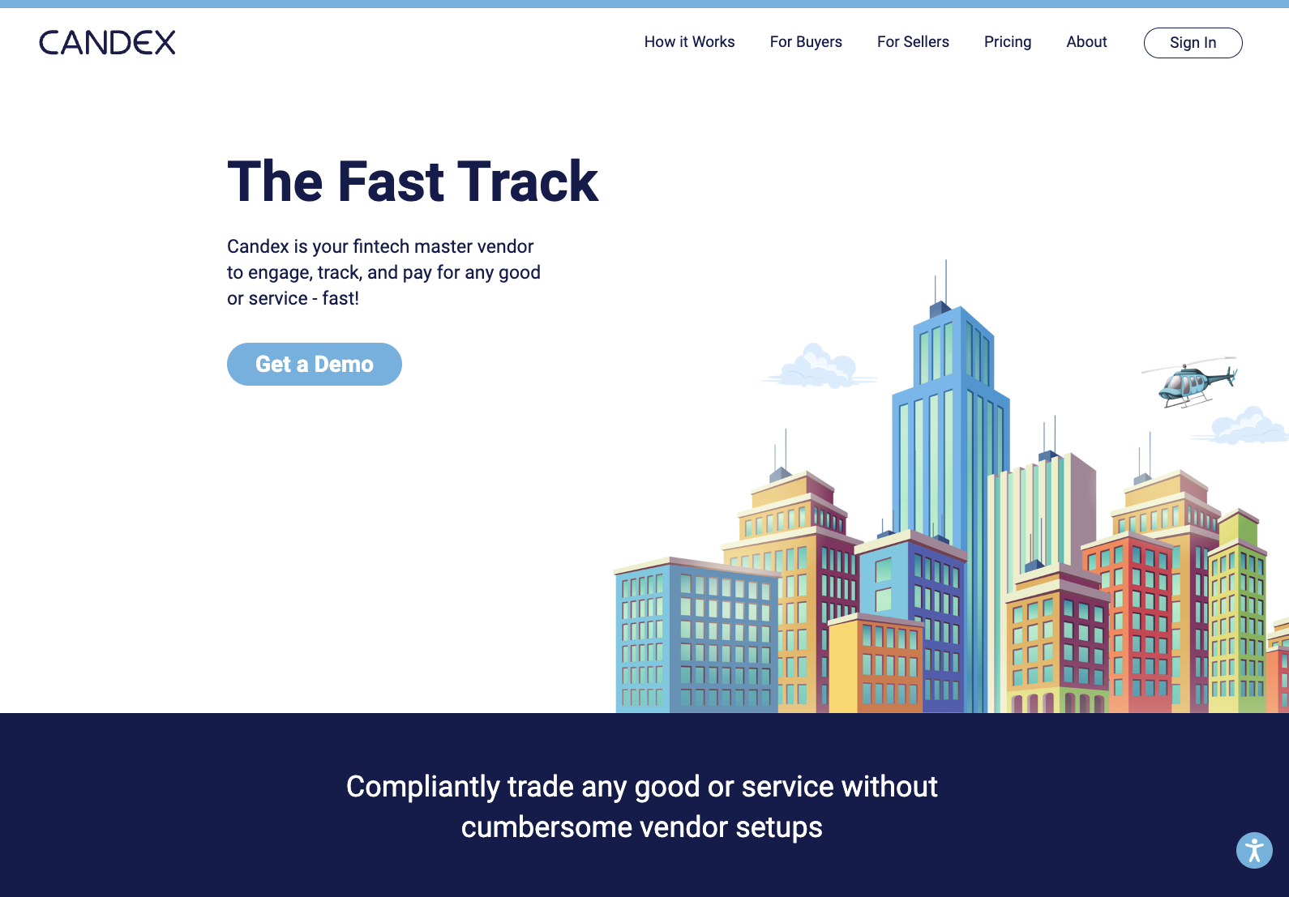
PAYEE
Repeat Payee Login
If Payee has already registered with Candex, simply login using your email address and password previously created

Slide 6
PAYEE
Miller & Sons
Speaking Engagement - January Zebra
search
Payee Accepts Standard Terms
Purchasing Terms Speaking Engagement - January | print ✕
Payment Expectations After you request payment and Candex verifies your banking information, Candex will invoice Buyer. Payment terms are 5 days from the date Candex invoices Buyer and Candex will pay you within 3 business days of receiving payment from Buyer. The terms set forth in this Payment Expectations Section shall supersede any other payment terms included in any other sections of these Terms or in documents incorporated by reference into these Terms. Additional Order Terms between Buyer & Seller This purchase order ("Order") is placed subject to the terms, conditions, specifications, and instructions stated herein and on any attachments or schedules hereto, all of which together shall constitute the complete Order. By (i) performing services or delivering goods as specified in this Order, as applicable, (ii) issuing an invoice to Buyer (as defined below), or (iii) accepting payment from Buyer for goods or services, as applicable, provided under this Order, whichever occurs first, you (hereinafter "Vendor") agree to be bound by all applicable terms, conditions, specifications, instructions, attachments and schedules set forth herein. This Order may not be modified or supplemented, except by a written instrument signed by an authorized representative of Zebra, whichever is applicable and more particularly identified on this Order, and/or one of its Affiliates, as applicable (hereinafter "Buyer").
Delivery Date
▢ I have also read and agreed with Zebra Code of Conduct
My Activity My Requests Order Feed Settings
1
Speaking Engagement - January Zebra
ORDERS
Speaking Engagement - January
This is an order sent to you by David London at Zebra through Candex.
1
Speaking Engagement - January
1
Items |  |  | Authorized to Seller (USD)
Speaking Engagement - January By Jan 5 |  |  | 500
Bill To: | Deliver To:
Candex Solutions Limited 420 Lexington Avenue, Suite 300 New York, NY 10170 | VCU United States
Oct-1-2024
Review & Accept Terms
decline req
add colleague
print order
I Accept These Terms
January 16, 2024
Created by David London
Invite to order was sent out. zack@miller.com needs to accept terms.
Zack Miller
Online
Notes:
When the vendor clicks view order, this is the registration page that they will see. They can select their language and fill in some pretty easy information which usually takes under a minute.

Slide 7
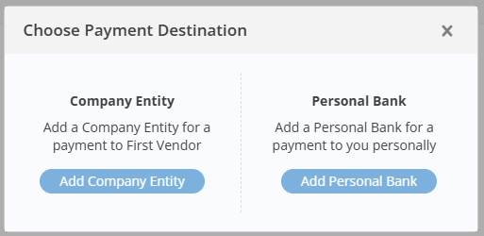
PAYEE
Miller & Sons
Request Payment
search
? Sign out
Add Payment Details
?
My Activity My Requests Order Feed Settings
Speaking Engagement - January PO# 67564453535
1
Invite Finance
Pay To:
Add Detail
ORDERS
Speaking Engagement - January
Bill To: | Deliver To:
Candex Solutions Limited 420 Lexington Avenue, Suite 300 New York, NY 10170 | VCU United States
Tax ID #: 45-2805653
1
speaking engagement - ja…
1
Add Detail
Item Designate the “Pay To” and upload invoice(s)
Entity
Bank Details
Name
Bank Name
Country
United States ▾
Bank Country
United States ▾
Address
Currency
USD ▾
City
Account Holder
?
Account #
Zip Code
?
- select - ▾
ACH Routing#
Tax Classification
?
Get Paid
Skip for Now
W9
Upload File
+ Add intermediary bank
?
Add
Zack Miller
Online
7

Slide 8
PAYEE
Miller & Sons
Request Payment
search
? Sign out
Request Payment
?
My Activity My Requests Order Feed Settings
Speaking Engagement - January PO# 67564453535
Click here to invite finance team to complete payment request
1
Invite Finance
Pay To:
(US / USD) Zack Miller ▾
Account: Citibank: ********291
ORDERS
Speaking Engagement - January
Bill To: | Deliver To:
Candex Solutions Inc 420 Lexington Avenue, Suite 300 New York, NY 10170 | VCU United States
Tax ID #: 45-2805653
1
speaking engagement - ja…
1
Item (USD)
You Get
Tax
Click here to edit taxes. Payees not needing to claim taxes must enter 0.
Speaking Engagement - January
500
0
view/edit
500
Total Amount | 500
Tax | -
Due to You | 500
Get Paid
Skip for Now
Zack Miller
Online
8

Slide 9
PAYEE
Miller & Sons
Request Payment
search
? Sign out
?
Withholding
Default withholding amount is shown in table If payee asserts that withholding does not apply to them, choose the option that suits their situation with additional notes and Candex will follow-up
My Activity My Requests Order Feed Settings
1
Bill To: | Deliver To:
Candex Solutions Inc 420 Lexington Avenue, Suite 300 New York, NY 10170 | VCU United States
Tax ID #: 45-2805653
ORDERS
Speaking Engagement - January
Item (USD)
You Get
Tax
Speaking Engagement - January
500
0
view/edit
1
speaking engagement - ja…
1
500
Total Amount | 500
Tax | -
Total Invoice | 500
Withholding | (150)
Net Due | 350
1
Withholdings
As required by law, withholding taxes of 30% will be deducted for services performed in the United States.
Accept the 30% of withholding
Claim a reduction or exemption
Claim physical delivery outside the US
Claim an expense reimbursement
2
Candex withhold on your payments and issue you proof for your records and tax returns.
Zack Miller
Online
Get Paid
Skip for Now
9

Slide 10
PAYEE
Miller & Sons
? Sign out
Speaking Engagement - January
VCU
Payment Details ▾
search
?
+
Requisition Status Updates
A wall of history compiles on each order and important notifications are sent to Buyers’ and Payees’ emails. Candex reminds vigorously for the required actions of the Payees Candex proactively notifies Buyers if order acceptance has not occurred in 10 days
My Activity My Requests Order Feed Settings
Speaking Engagement - January By: Apr 4 | To: CA |  |  | 500
1
Seller Verified | Candex Invoice | Paid by Buyer | Paid to Seller
April 3, 2024
Seller:
 | Miller & Sons ▾ By zack Miller
✓
ORDERS
Speaking Engagement - January
Created by David London
David London invited zack@miller.com
A reminder to accept terms was sent to zack@miller.com
zack Miller added john.smith@miller.com
Buyer:
 | VCU ▾ By Candex #US74389010
1
✓
speaking engagement - …
1
C
Payment Click to comment
Payment has been accepted by Zack Miller
view detail
10:42 AM
Amount Sales Tax Total Amount | USD 500.00 - 500.00
Candex ID PO # Original Upload Last Update | 345435345345 CTPO1239045 Apr 3 Apr 3
April 5, 2024
C
Re: Payment
Candex has issued an invoice to VCU
11:23 AM
Invoice Date Payment Terms Paid to Candex Paid to Seller | Apr 5 XX days Apr 12 Apr 12
C
Re: Payment
VCU has paid Candex and the funds will be transferred to Zack Miller within 3 business days.
11:23 AM
Marketing
Speaking Engagement - January (Apr 3)
Service | USD 500.00
July 9, 2024
 | Bill to: Candex Solutions, Inc.
C
Re: Payment
Miller & Sons was paid
5:05 PM
 | Pay to: Miller & Sons, LLC
Zack Miller
Online
 | Ship to: United States
+
write something...
10
Notes:
If you do login to Candex, a wall of history compiles on each order and important notifications are sent to Buyers’ and Sellers’ emails. Candex reminds vigorously for the required actions of the Sellers
and Candex proactively notifies Buyers if order acceptance has not occurred in 10 days

Slide 11
PAYEE
Miller & Sons
search
? Sign out
Payment Entities
?
+
Edit Entity & Bank Details
To update entity details, select Settings, select Entities Click Save
My Activity My Requests Order Feed Settings
Back
Entity
+
1
Miller & Sons, LLC 1234 Main St. St. Louis, MO 28372 United States Tax ID: 438439428 | edit
Name
Miller & Sons LTDA
Country
United States ▾
Address
1234 Main St.
City
St. Louis
PERSONAL SETTINGS Preferences
Profile
COMPANY SETTINGS
Setup
Users & Teams
Entities
Zip code
28372
Tax ID #
US ▾
438439428
MO ▾
W9
Add File
Receiving Funds
Bank Details
Bank Country
United States ▾
Currency
USD ▾
Bank Name
Citibank
Account Name
Miller & Sons, LLC
?
Account #
9382930291
ACH Routing #
AAAA-BB-CC-123
?
+ add intermediary bank
?
Bank Verification
Use bank statement or voided check
Miller&Sons_Citi.pdf
replace
?
Zack Miller
Online
Save
11

Slide 12
PAYEE
Mobile Payment Request
Submitting payment request in Candex is available via Mobile Browser
candex.com
Add Invoice
Speaking Engagement - January VCU | PO#: CTPO1239045
Pay To: edit Account: Citibank ********291
Bill To: Candex Solutions, Inc 420 Lexington Ave New York, NY 10024
Deliver To: VCU 123 Main St. United States
Item(s) | Speaking Engagement - January by Jan 5
Amount | up to 3,500
Tax | -
Total Amount |  | 3,500
Tax |  | -
Due to You) |  | 3,500
C
?
VCU (via Candex) To: Zack Miller
Action Required - Accept Payment 12345678
Invite Finance
Speaking Engagement - January
United States | PO#: CTPO1239045
From
VCU
(US / USD) Miller & Sons, LLC ▾
Request Payment
To: zach@miller.com A payment of 500 USD is authorized to you. Items: • Speaking Engagement - January Click here to get paid. VCU Industries uses Candex to engage and pay its valued and trusted partners without going through a cumbersome setup process
Candex allows businesses to engage and exchange payments in a compliant way without cumbersome setup in each other’s financial systems. View FAQs Support at support@candex.com
view/edit
3,500
Submit
Skip for Now
12
Notes:
If you do login to Candex, a wall of history compiles on each order and important notifications are sent to Buyers’ and Sellers’ emails. Candex reminds vigorously for the required actions of the Sellers
and Candex proactively notifies Buyers if order acceptance has not occurred in 10 days

Slide 13
Questions?
www.candex.com/help | support@candex.com

