Slide 1


The fast track
Payee Experience for Participants
Notes:
We call Candex the fast track because it is the fast, easy & compliant way to make low value or one time purchases.

Slide 2
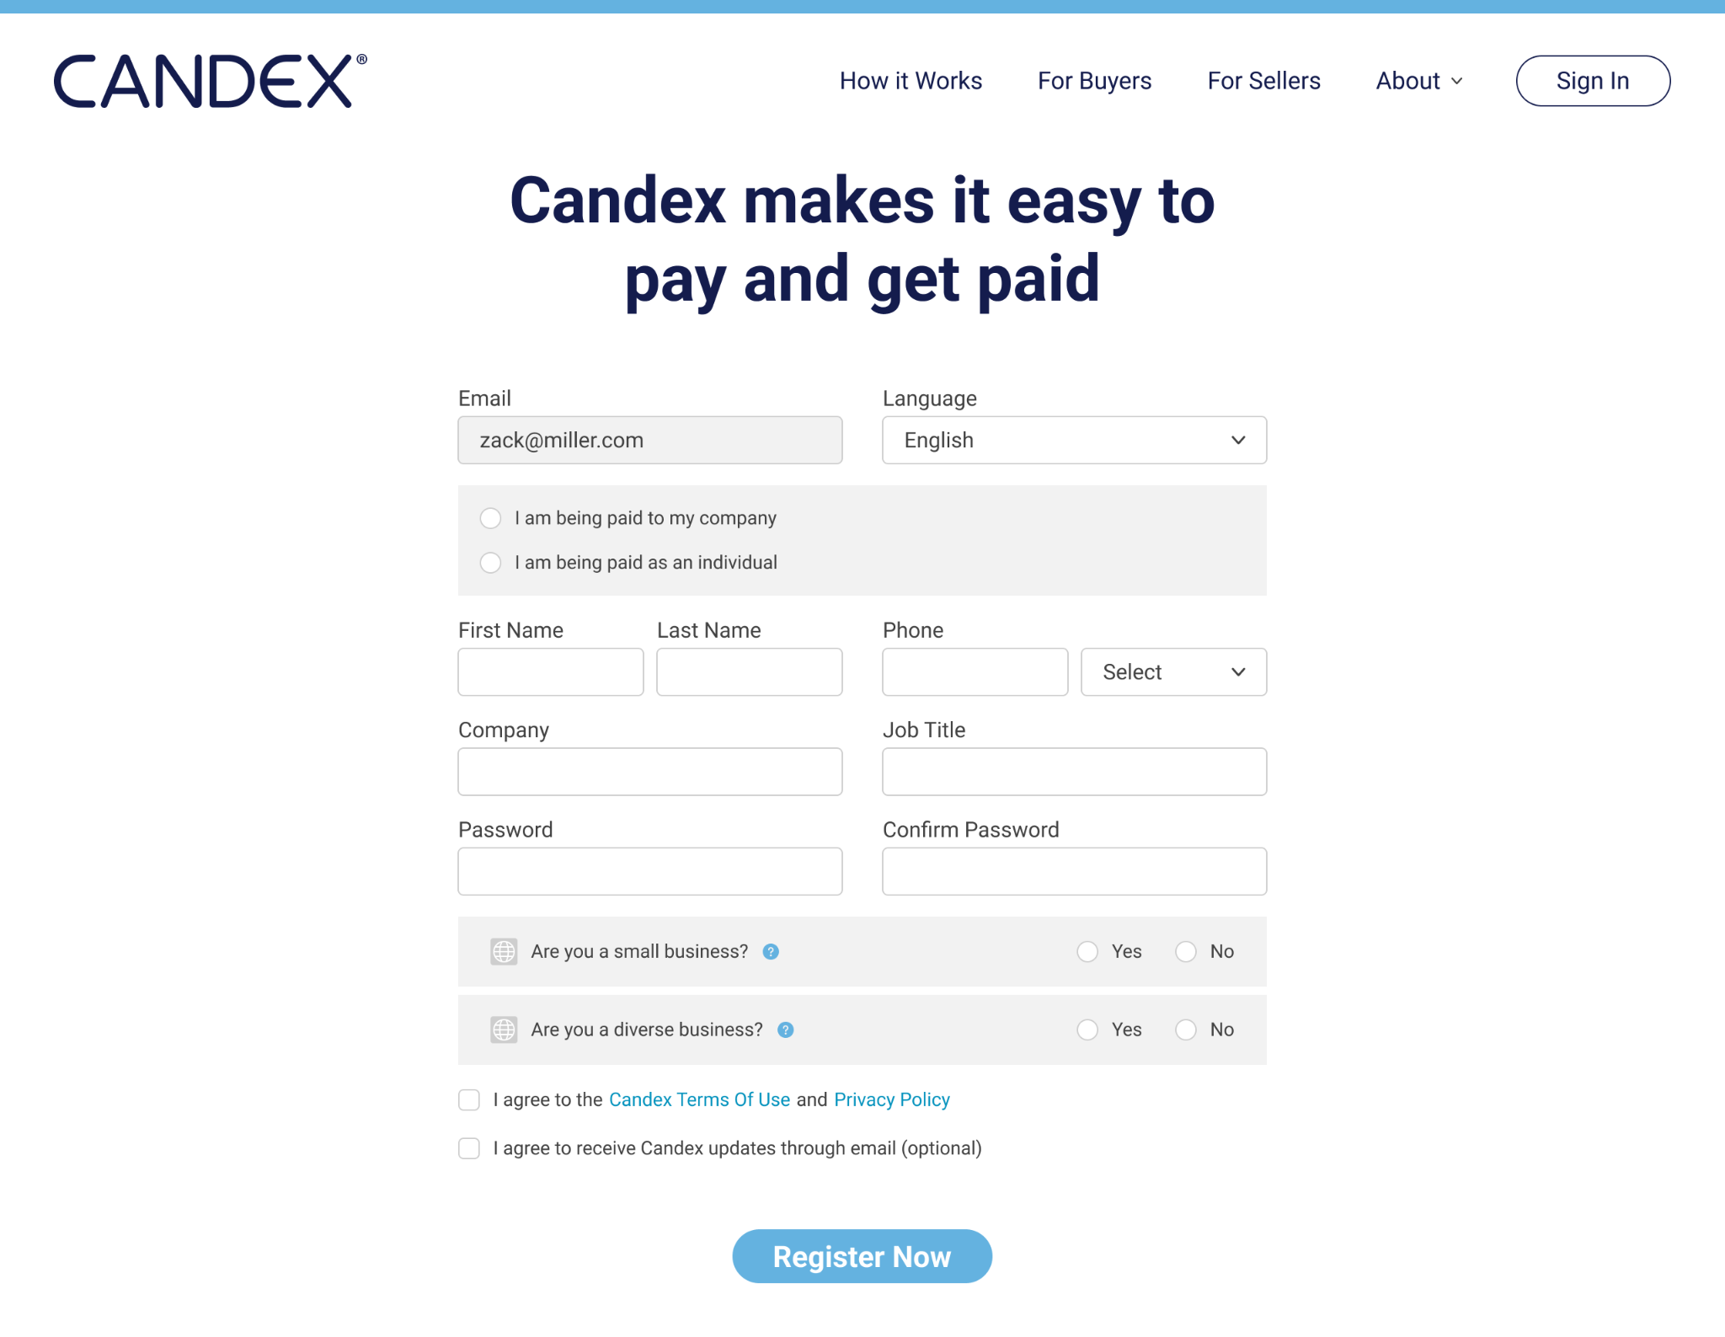
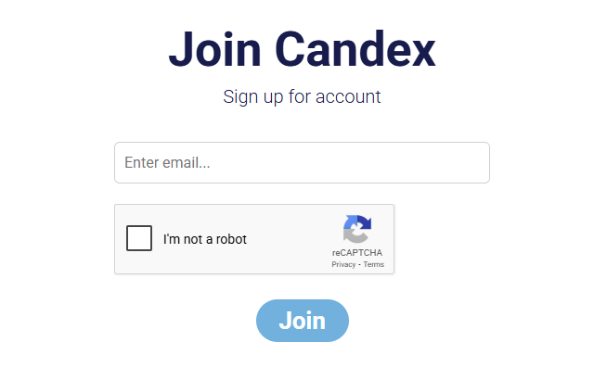
Pre-Register Participant
Register your participant prior to receiving a payment An email will be sent to their inbox Click the link to register
A. If Payee is being paid as part of company
B. If Payee is being paid as an individual
Not shown if Payee selects ‘B’
Not shown if Payee selects ‘B’

Slide 3

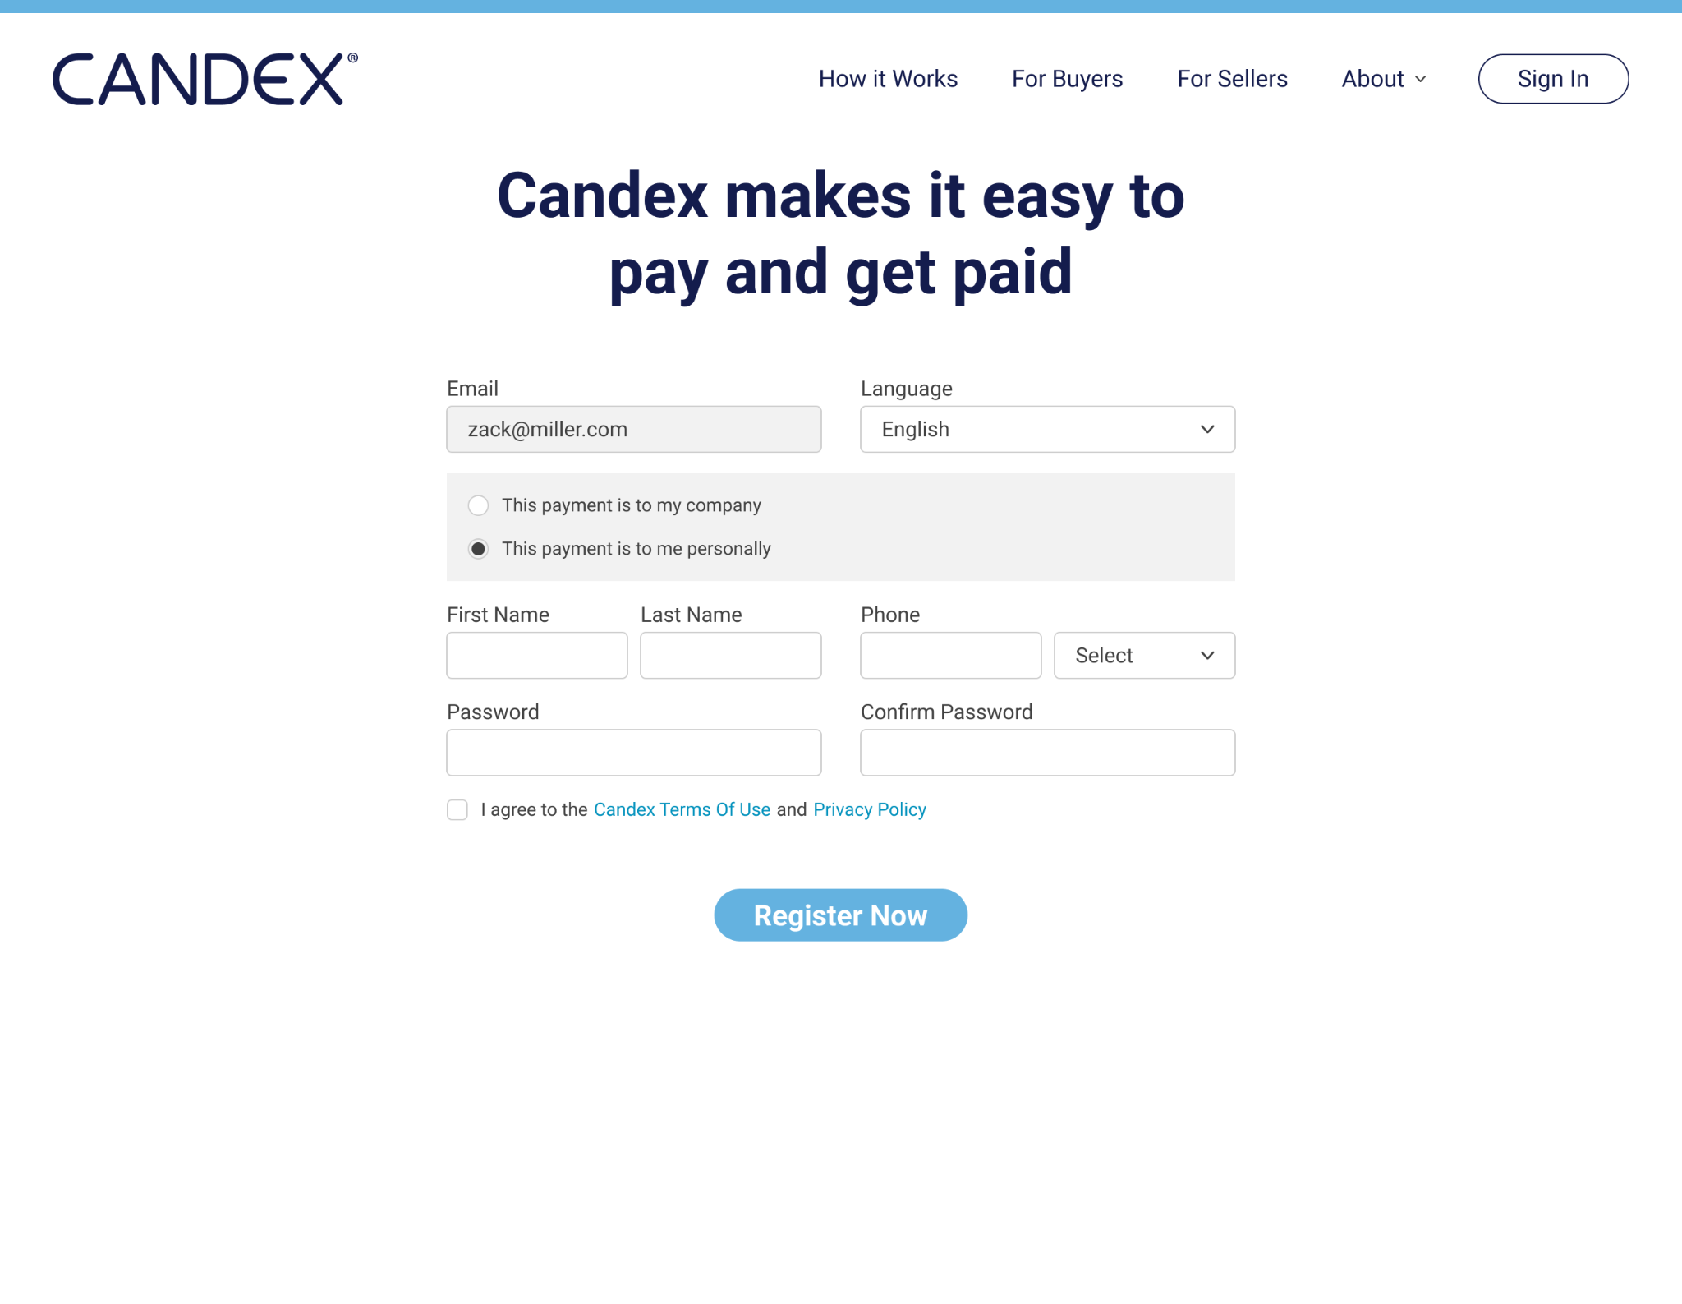
PAYEE
Simple Payee Registration
Users can select their language To be filled out ONLY on initial engagement
Select “This Payment is to me personally” as an individual payee

Slide 4
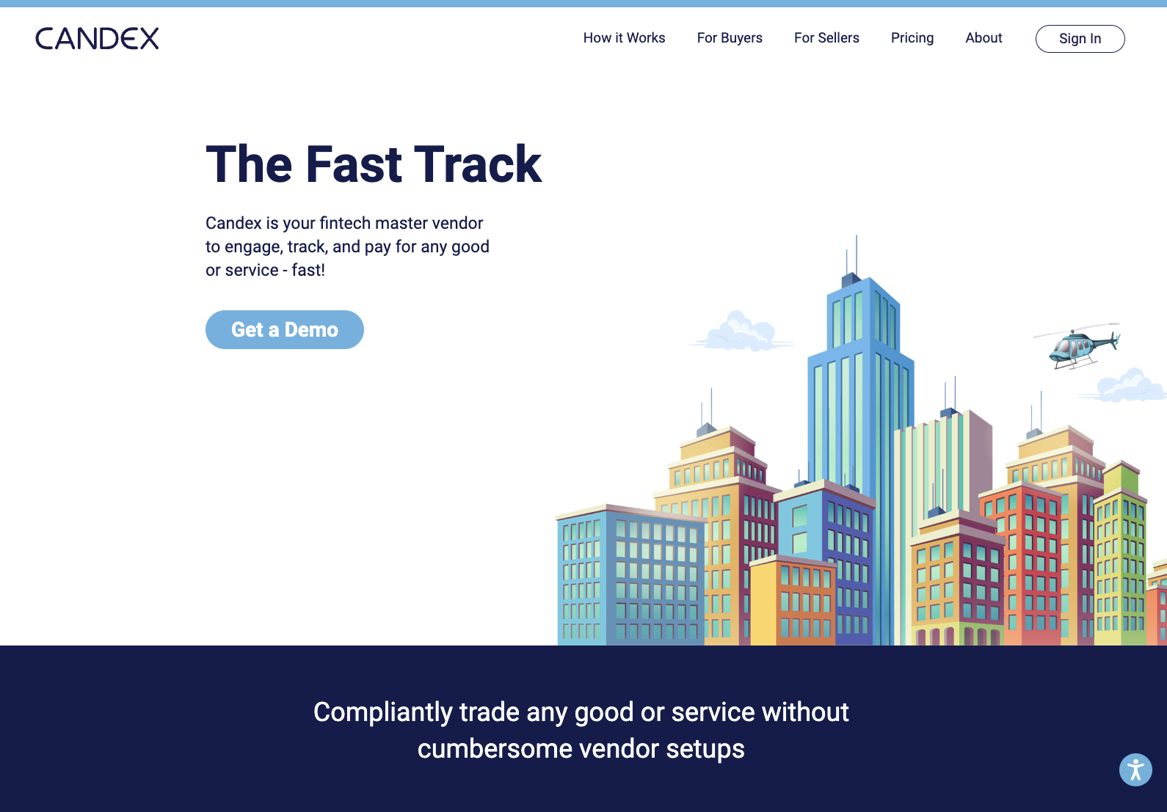
PAYEE
Repeat Payee Login
If Payee has already registered with Candex, simply login using your email address and password previously created

Slide 5
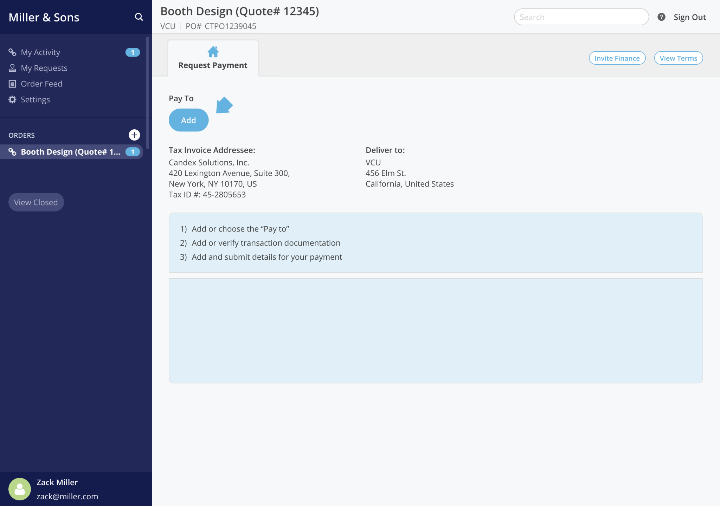
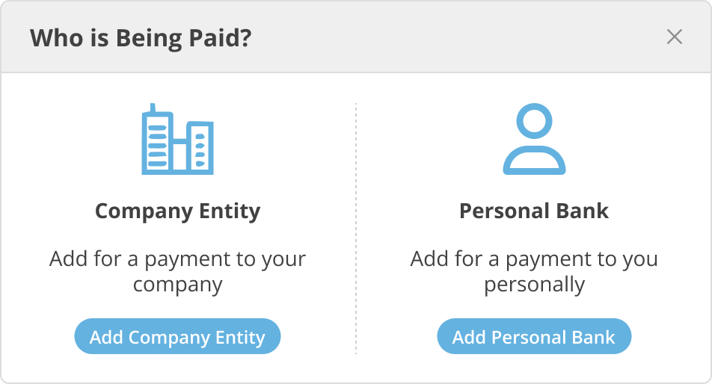
Start Payment Request by Adding “Pay To” Details

Slide 6
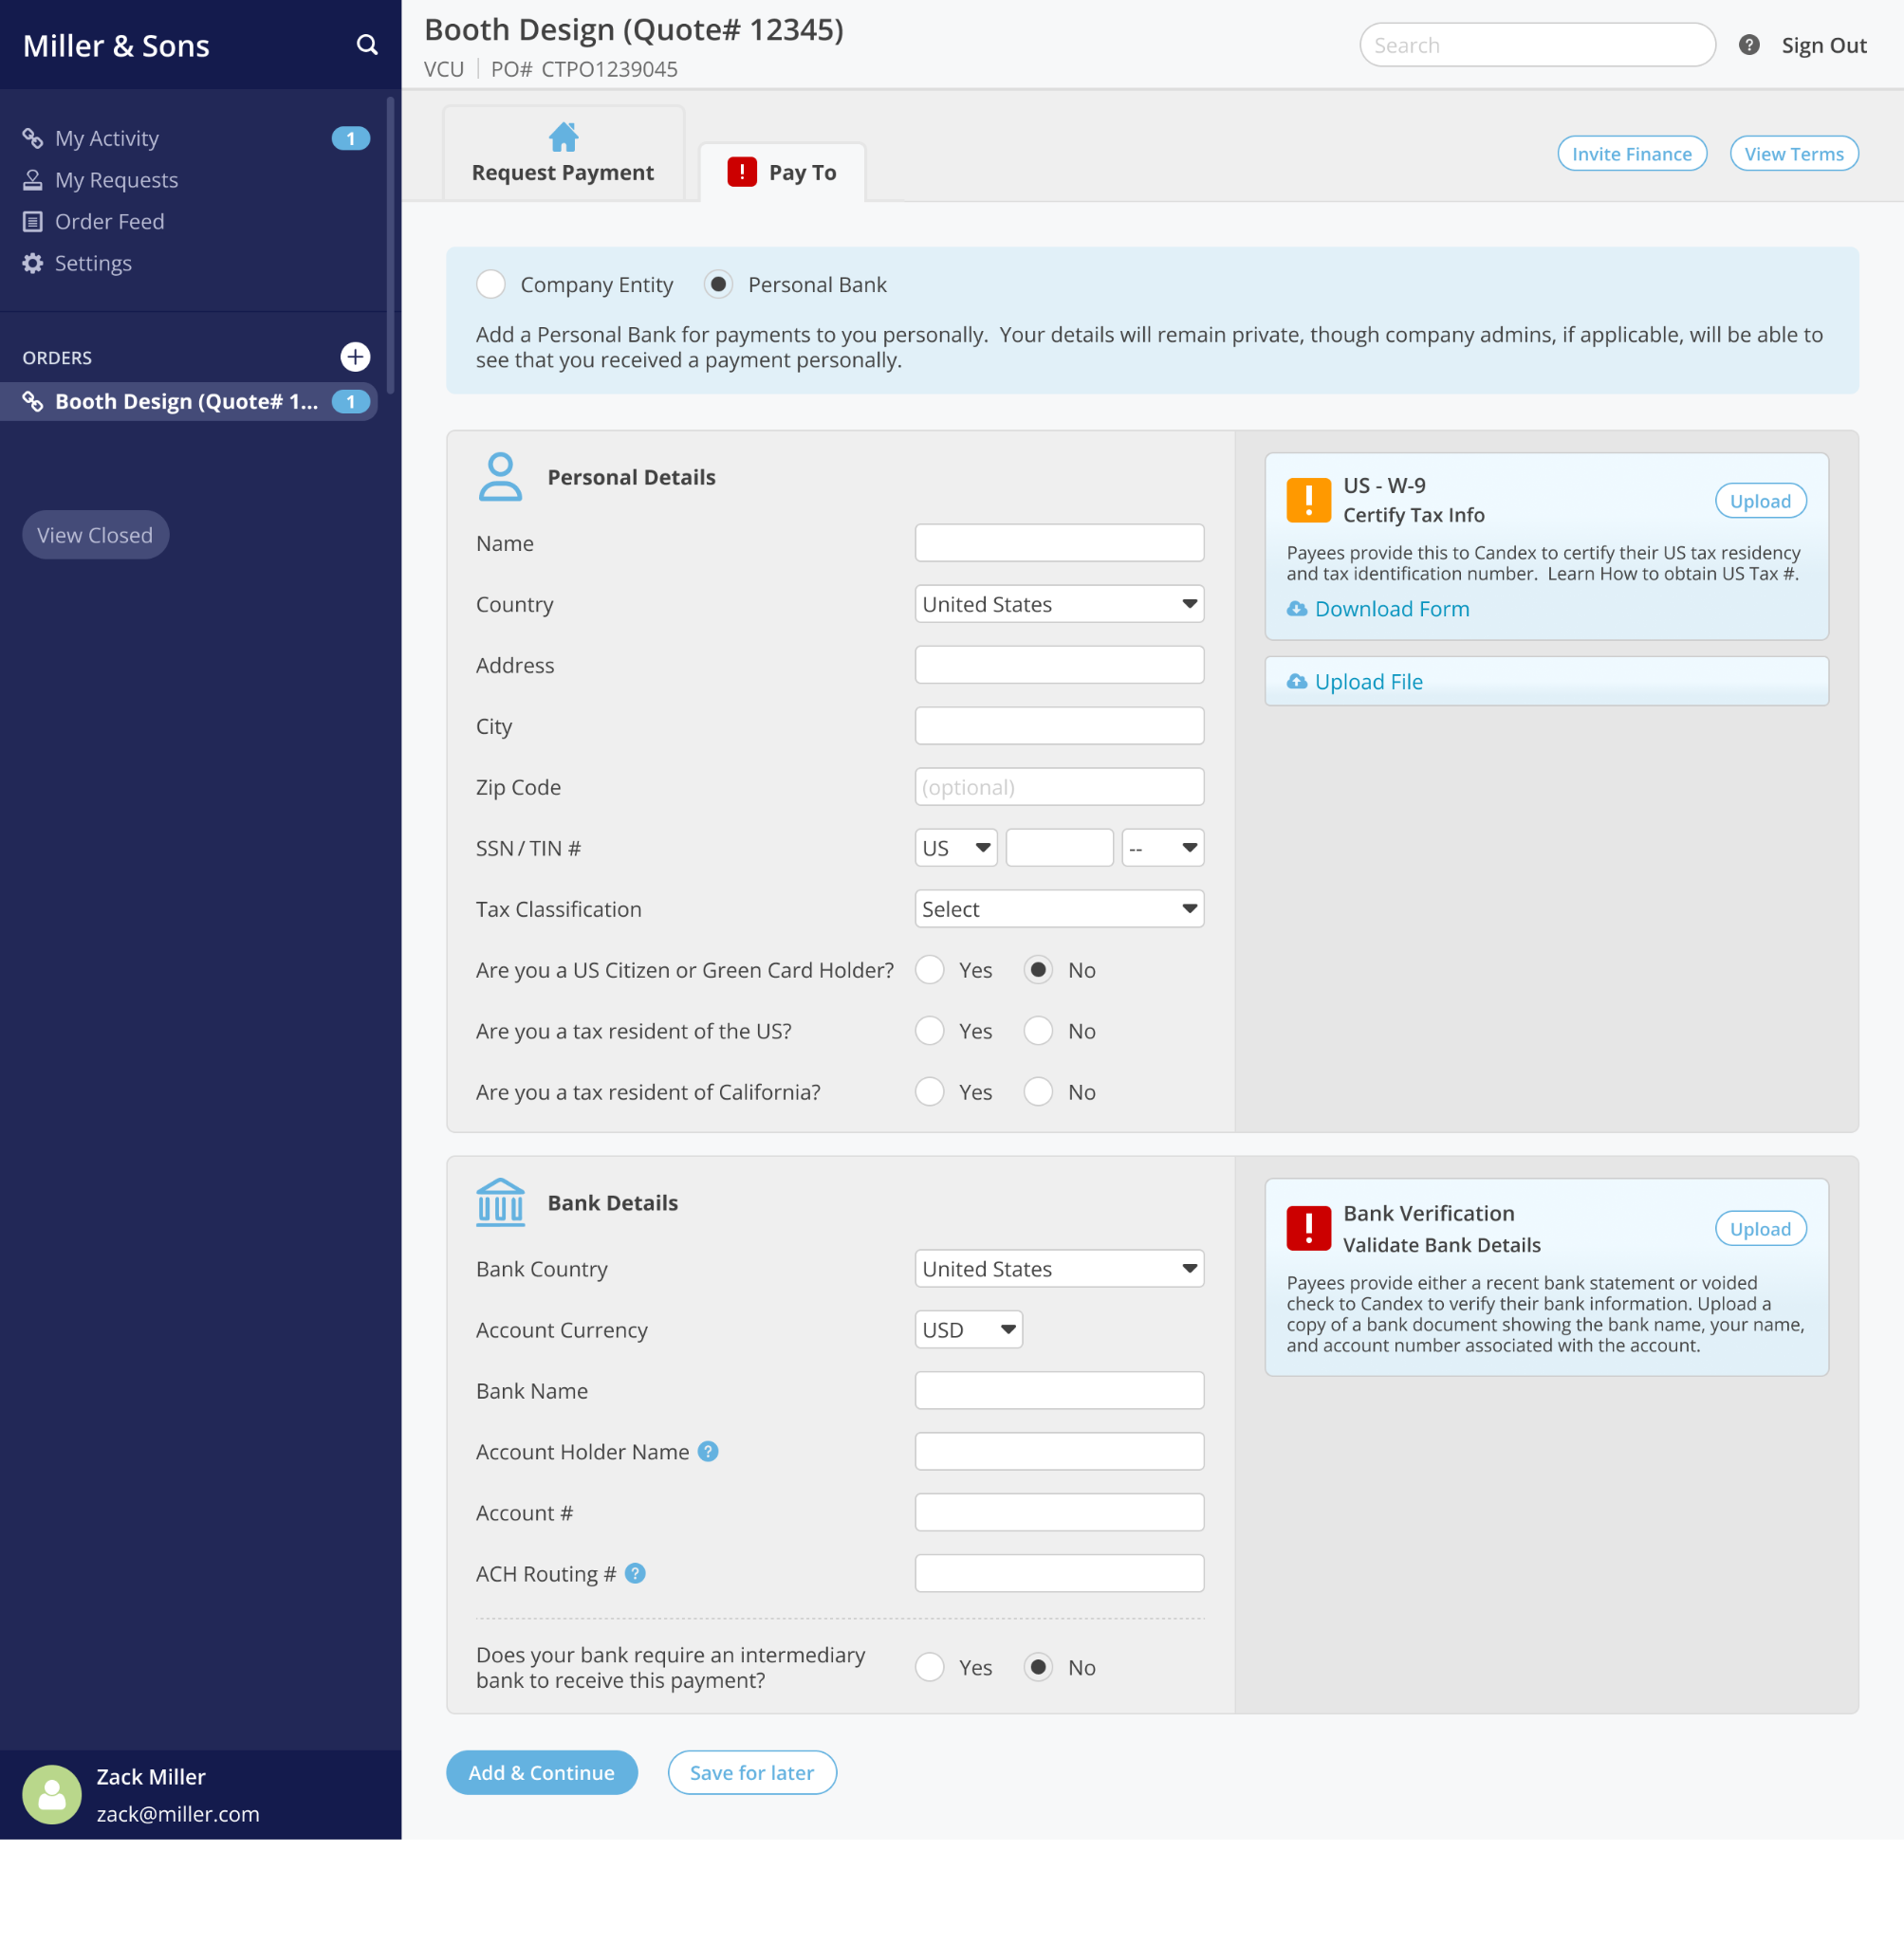
Payee Adds Billing Details
The vendor adds business, tax and banking information Candex uses this information to run verifications, sanctions screens, and AML procedures

Slide 7
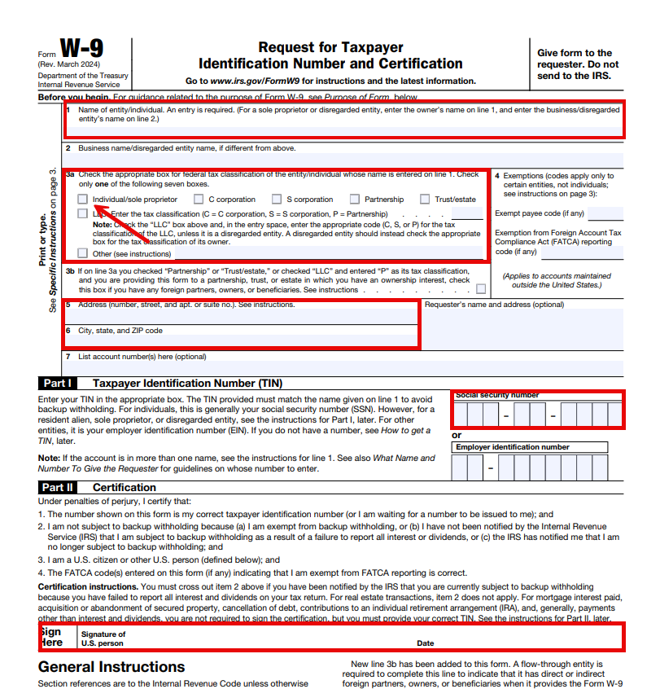
Upload W9
Download the W9 template Complete the form and upload into Candex

Slide 8
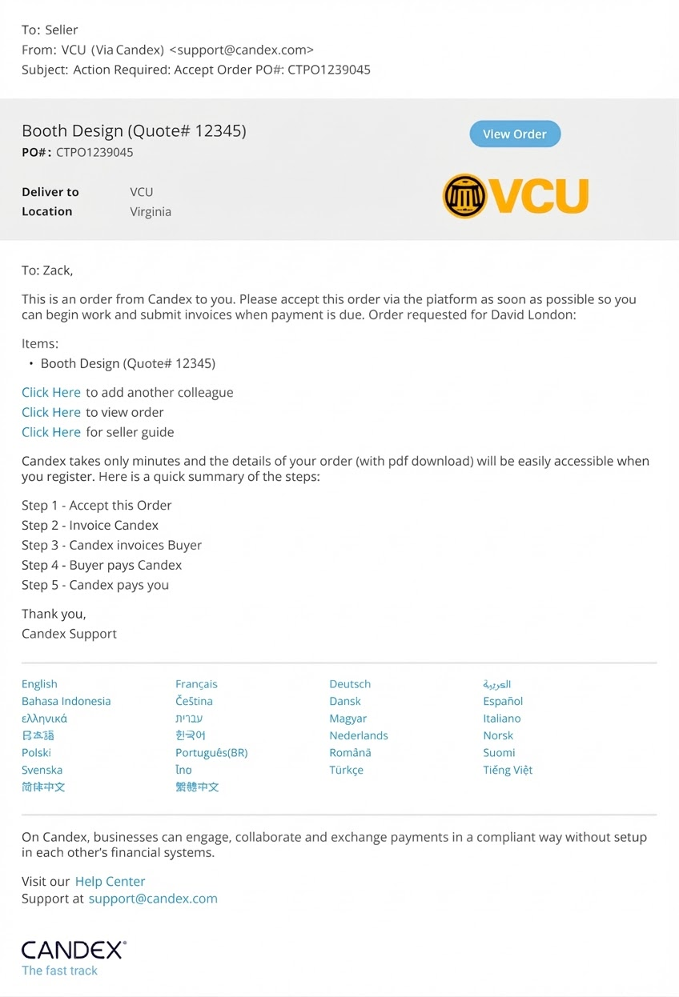
Payee Invite
Process the payment in RealSource Payee receives invitation to receive payment Reminders sent regularly to to Payees

Slide 9
PAYEE
Payee Login
Payee has already registered with Candex, simply login using your email address and password previously created

Slide 10
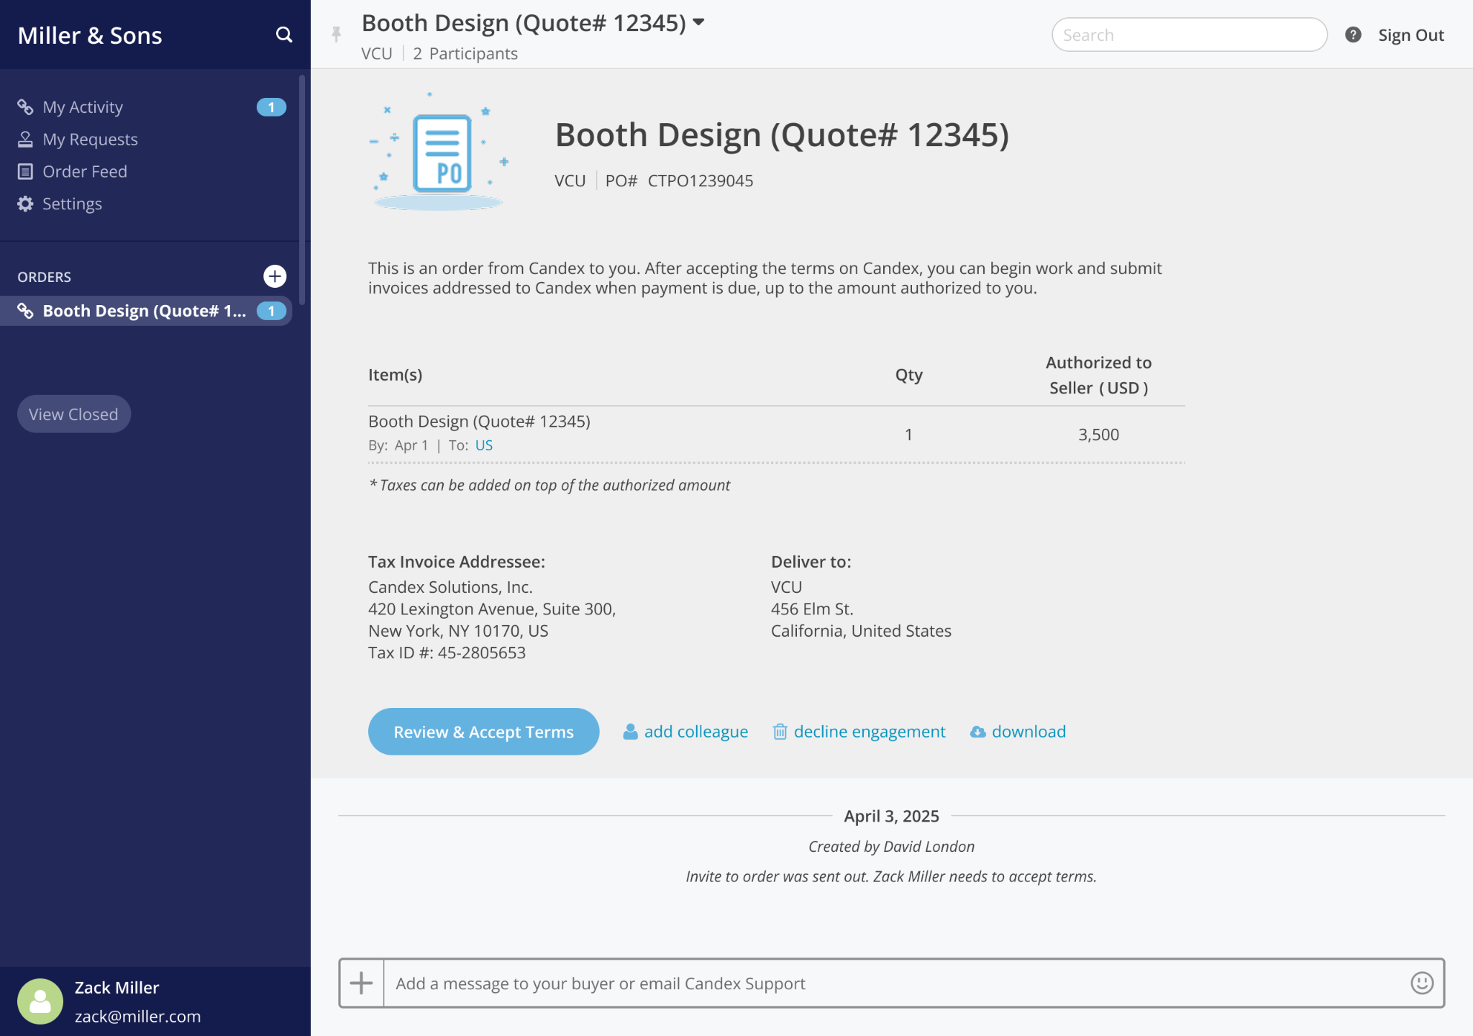
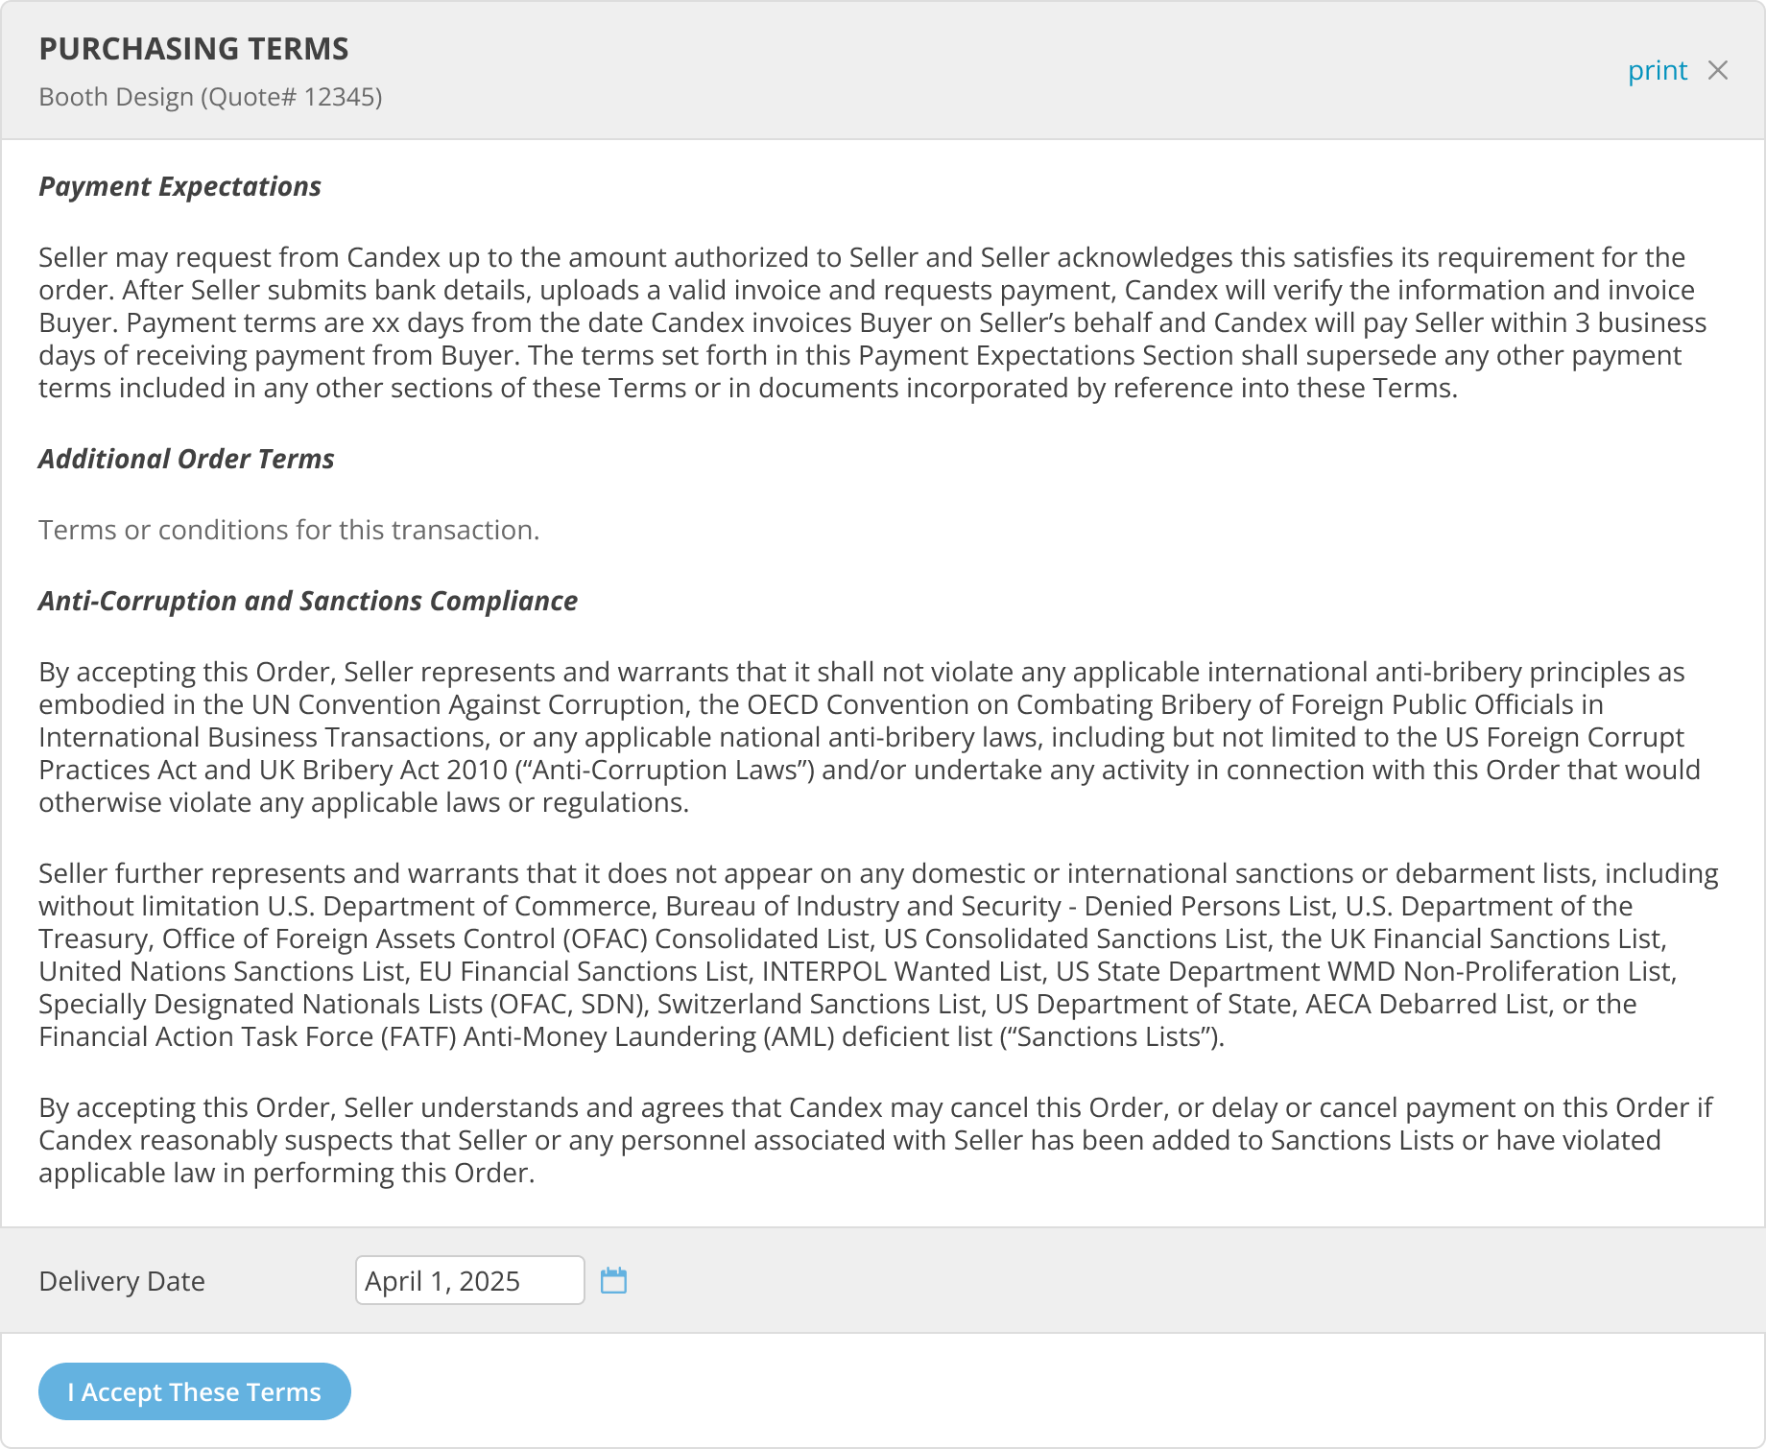
Payee Accepts Standard Terms

Slide 11






PAYEE
Miller & Sons
Request Payment
search
? Sign out
Request Payment
?
My Activity My Requests Order Feed Settings
Speaking Engagement - January PO# 67564453535
Click here to invite finance team to complete payment request
1
Invite Finance
After you request payment and Candex verifies your banking information, Candex will invoice Buyer on your behalf. The funds should reach your account within 3 business days of Buyer's acceptance of Candex's invoice.
ORDERS
Speaking Engagement - January
(US / USD) Zack Miller ▾
Pay To:
Account: Citibank: ********291
1
speaking engagement - ja…
1
Bill To: | Deliver To:
Candex Solutions Inc 420 Lexington Avenue, Suite 300 New York, NY 10170 | VCU 907 Floyd Ave, Richmond, VA 23284, United States
Tax ID #: 45-2805653
You Get
Tax
Item (USD)
Click here to edit taxes. Payees not needing to claim taxes must enter 0.
Speaking Engagement - January
500
0
view/edit
500
Total Amount | 500
Tax | -
Due to You | 500
Submit
Skip for Now
Zack Miller
Online

Slide 12

PAYEE
Miller & Sons
? Sign out
Speaking Engagement - January
Virginia Commonwealth University (VCU)
Payment Details ▾
search
?
+
Requisition Status Updates
A wall of history compiles on each order and important notifications are sent to Buyers’ and Payees’ emails. Candex reminds vigorously for the required actions of the Payees Candex proactively notifies Buyers if order acceptance has not occurred in 10 days
My Activity My Requests Order Feed Settings
Speaking Engagement - January By: Apr 4 | To: CA |  |  | 500
1
Seller Verified | Candex Invoice | Paid by Buyer | Paid to Seller
April 3, 2025
Seller:
 | Miller & Sons ▾ By zack Miller
✓
ORDERS
Speaking Engagement - January
Created by David London
David London invited zack@miller.com
A reminder to accept terms was sent to zack@miller.com
zack Miller added john.smith@miller.com
Buyer:
 | Virginia Commonwealth University (VCU) ▾ By Candex #US74389010
1
✓
speaking engagement - …
1
C
Payment Click to comment
Payment has been accepted by Zack Miller
view detail
10:42 AM
Amount Sales Tax Total Amount | USD 500.00 - 500.00
Candex ID PO # Original Upload Last Update | 345435345345 CTPO1239045 Apr 3 Apr 3
April 5, 2025
C
Re: Payment
Candex has issued an invoice to Virginia Commonwealth University (VCU)
11:23 AM
Invoice Date Payment Terms Paid to Candex Paid to Seller | Apr 5 XX days Apr 12 Apr 12
C
Re: Payment
Virginia Commonwealth University (VCU) has paid Candex and the funds will be transferred to Zack Miller within 3 business days.
11:23 AM
Marketing
Speaking Engagement - January (Apr 3)
Service | USD 500.00
July 9, 2025
 | Bill to: Candex Solutions, Inc.
C
Re: Payment
Miller & Sons was paid
5:05 PM
 | Pay to: Miller & Sons, LLC
Zack Miller
Online
 | Ship to: United States
+
write something...
12
Notes:
If you do login to Candex, a wall of history compiles on each order and important notifications are sent to Buyers’ and Sellers’ emails. Candex reminds vigorously for the required actions of the Sellers
and Candex proactively notifies Buyers if order acceptance has not occurred in 10 days

Slide 13




PAYEE
Miller & Sons
search
? Sign out
Payment Entities
?
+
Edit Entity & Bank Details
To update entity details, select Settings, select Entities Click Save
My Activity My Requests Order Feed Settings
Back
Entity
+
1
Miller & Sons, LLC 1234 Main St. St. Louis, MO 28372 United States Tax ID: 438439428 | edit
Name
Miller & Sons LTDA
Country
United States ▾
Address
1234 Main St.
City
St. Louis
PERSONAL SETTINGS Preferences
Profile
COMPANY SETTINGS
Setup
Users & Teams
Entities
Zip code
28372
Tax ID #
US ▾
438439428
MO ▾
W9
Add File
Receiving Funds
Bank Details
Bank Country
United States ▾
Currency
USD ▾
Bank Name
Citibank
Account Name
Miller & Sons, LLC
?
Account #
9382930291
ACH Routing #
AAAA-BB-CC-123
?
+ add intermediary bank
?
Bank Verification
Use bank statement or voided check
Miller&Sons_Citi.pdf
replace
?
Zack Miller
Online
Save
13

Slide 14


Payee
Mobile Payment Request
Submitting payment request in Candex is available via Mobile Browser
candex.com
Add Invoice
Speaking Engagement - January VCU | PO#: CTPO1239045
After you request payment and Candex verifies your banking information, Candex will invoice Buyer on your behalf. The funds should reach your account within 7 business days of Buyer's acceptance of Candex's invoice.
Pay To: edit Account: Citibank ********291
Bill To: Candex Solutions, Inc 420 Lexington Ave New York, NY 10024
Deliver To: VCU 907 Floyd Ave, Richmond, VA 23284, United States
Item(s) | Speaking Engagement - January by Jan 5
Amount | up to 3,500
Tax | -
Total Amount |  | 3,500
Tax |  | -
Due to You) |  | 3,500
C
?
VCU (via Candex) To: Zack Miller
Action Required - Accept Payment 12345678
Invite Finance
Speaking Engagement - January
Virginia | PO#: CTPO1239045
From
VCU
Request Payment
(US / USD) Miller & Sons, LLC ▾
To: zach@miller.com A payment of 500 USD is authorized to you. Items: • Speaking Engagement - January Click here to get paid. VCU uses Candex to engage and pay its valued and trusted partners without going through a cumbersome setup process
Candex allows businesses to engage and exchange payments in a compliant way without cumbersome setup in each other’s financial systems. View FAQs Support at support@candex.com
3,500
view/edit
Submit
Skip for Now
14
Notes:
If you do login to Candex, a wall of history compiles on each order and important notifications are sent to Buyers’ and Sellers’ emails. Candex reminds vigorously for the required actions of the Sellers
and Candex proactively notifies Buyers if order acceptance has not occurred in 10 days

Slide 15
Questions?
www.candex.com/help | support@candex.com

